Slide 1
Word count Program
Dr.Preethi Ananthachari
Endicott college of International Studies
Woosong University
Preethi.ga@wsu.ac.kr

Slide 2
WordCount
Copy the wordcount program from the link
https://hadoop.apache.org/docs/r1.2.1/mapred_tutorial.html
In the Ubuntu/hadoop user, open and type “gedit WordCount.java”
Paste the wordcount program in the java file.

Slide 3
Switch user “su hduser”
Create a folder to put all java files. (For Ex: Myjava)
Run all the commands inside the folder

Slide 4
Go inside the Myjava folder and execute the command.
Javac WordCount.java –cp $(hadoop classpath)

Slide 5

Create two files

Slide 6
File creation
Create two files and write some similar words.
File1 – Hello hadoop welcome hadoop
File2 – Hello hadoop Byebye hadoop tough hadoop
In hduser, create /home/hadoop/input path
Hadoop fs –mkdir /home/hadoop/input
Hadoop fs –put file1 /home/hadoop/input
Hadoop fs –put file2 /home/hadoop/input

Slide 7
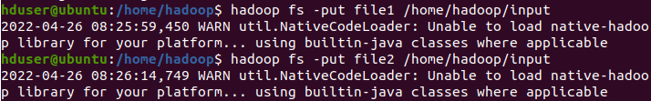
Copy the files

Slide 8
Environment variables
Sudo nano /etc/profile
export JAVA_HOME=/usr/jvm..
export PATH=${JAVA_HOME}/bin:${PATH}
export HADOOP_CLASSPATH=$JAVA_HOME/lib/tools.jar

Slide 9
Go inside Myjava folder,
Javac WordCount.java –cp $(hadoop classpath)
Echo $HADOOP_CLASSPATH
Jar cf WordCount.jar WordCount*.class
hadoop jar WordCount.jar WordCount /home/hadoop/input /home/hadoop/output

Slide 10
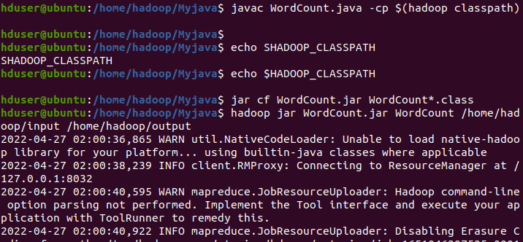
Execute jar file

Slide 11
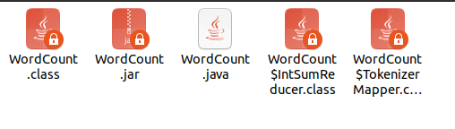
After executing jar

Slide 12
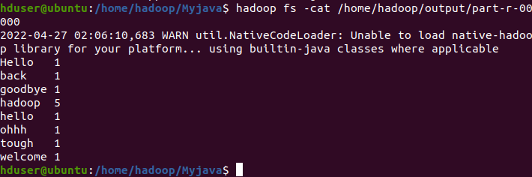
Result

